Slide 1
Unit Test
Carlos.Leigue@Jalasoft.com

Slide 2
Agenda
Definition
Properties
Positive, Negative
External Dependencies
Refactor

Slide 3

Unit Test
Definition
Automated piece of code that invokes another piece of code (a work unit) being tested and checks some assumptions about a single end result of the invocation.

Slide 4
Unit Test
Properties
Should be:
Automated
Repeatable
Consistent in results
Independent (fully isolated)
Easy to implement
Run quickly
Readable
Maintainable

Slide 5
Unit Test
Positive, Negative
Positive testing valid input data, behaving as expected?
Negative testing invalid input data, behaving as expected?

Slide 6
Unit Test
External Dependencies
Objects in the system that interact with the code under test over which you don’t have control.
e.g., memory, time, filesystem

Slide 7
Unit Test
External Dependencies
Fake
Denotes an object that looks like another object but can be used as a mock or a stub and can be handwritten or not.
Stub
Controllable replacement for a dependency in the system.
Help us test the code without dealing with the dependency directly.
Mock
Fake object in the system that decides if a unit test passes or fails, it does by verifying if the object under test called the fake object as expected.

Slide 8
Unit Test
External Dependencies
Value-based testing
Does a verification of the value returned by an executed method comparing it with an assumed (expected) value.
State-based testing (state verification)
Determines if an executed method worked correctly by checking the behavior/state of the system under test.
Interaction testing
Verifies how an object send messages (calls methods) to other objects.

Slide 9
Unit Test
Refactor
Act of changing code without changing the functionality.
Extract an interface/abstract class that holds the dependency to allow replacing the underlying implementation
Inject a fake at constructor level
Inject a fake as a property set
Inject a fake before a method call
A parameter to the method (parameter injection)
A factory class
A factory method

Slide 10
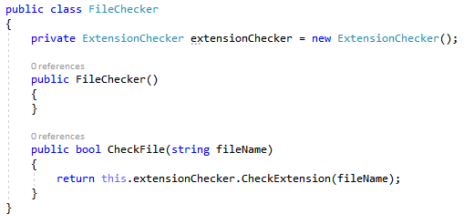
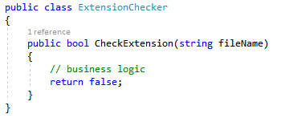
Unit Test
Refactor – Stub

Slide 11
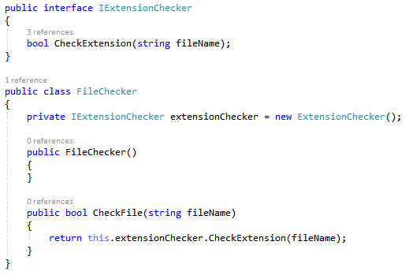
Unit Test
Refactor – Stub

Slide 12
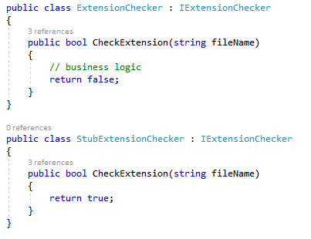
Unit Test
Refactor – Stub

Slide 13
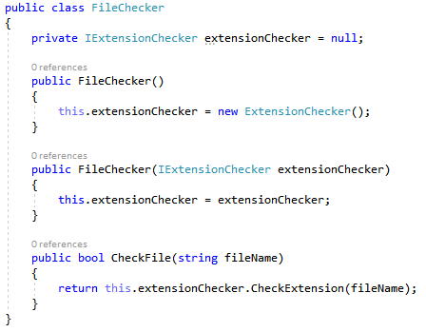
Unit Test
Refactor – Stub (inject through ctor)

Slide 14
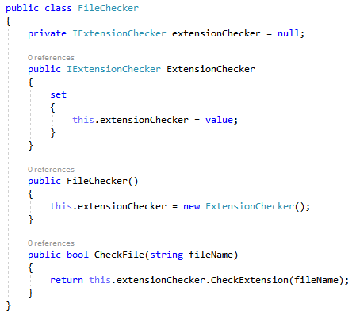
Unit Test
Refactor – Stub (inject through property)

Slide 15
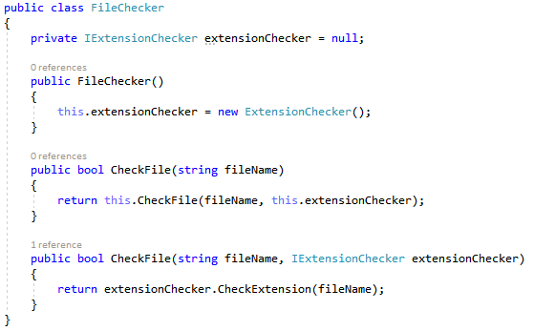
Unit Test
Refactor – Stub (inject through method parameter)

Slide 16
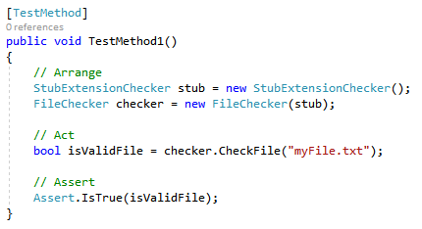
Unit Test
Refactor – Stub (Test)

Slide 17
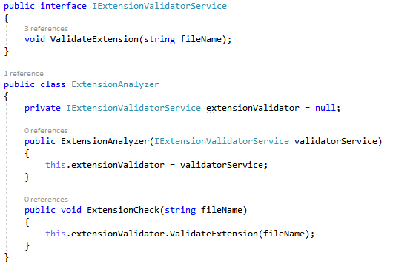
Unit Test
Refactor – Mock

Slide 18
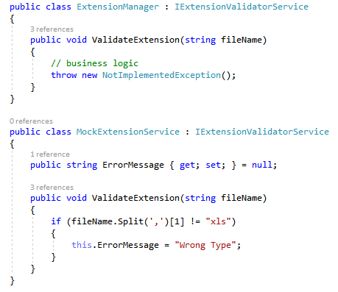
Unit Test
Refactor – Mock

Slide 19
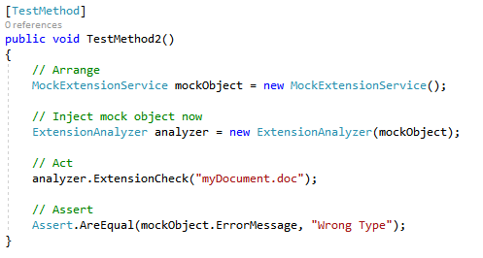
Unit Test
Refactor – Mock

